Slide 1
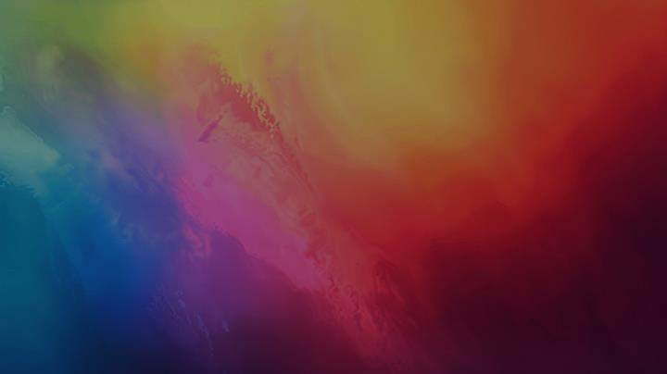



Effects Of
Colors
On Mind & Behavior

Slide 2

Color psychology studies how colors impact emotions and behavior.
Different colors can make us feel excited, calm, happy, or even anxious.
Colors play a big role in design, marketing, and personal choices.
Psychology of Colors

Slide 3
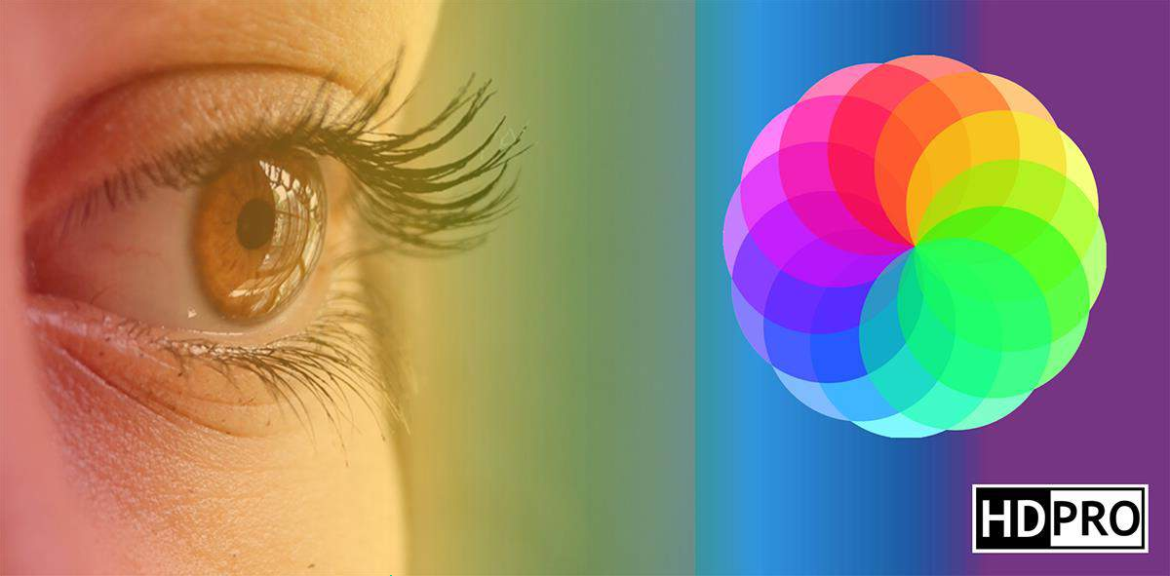

Color Perception
Our brains process color information through specialized cells in our eyes. This triggers neural
responses and emotional associations.

Slide 4


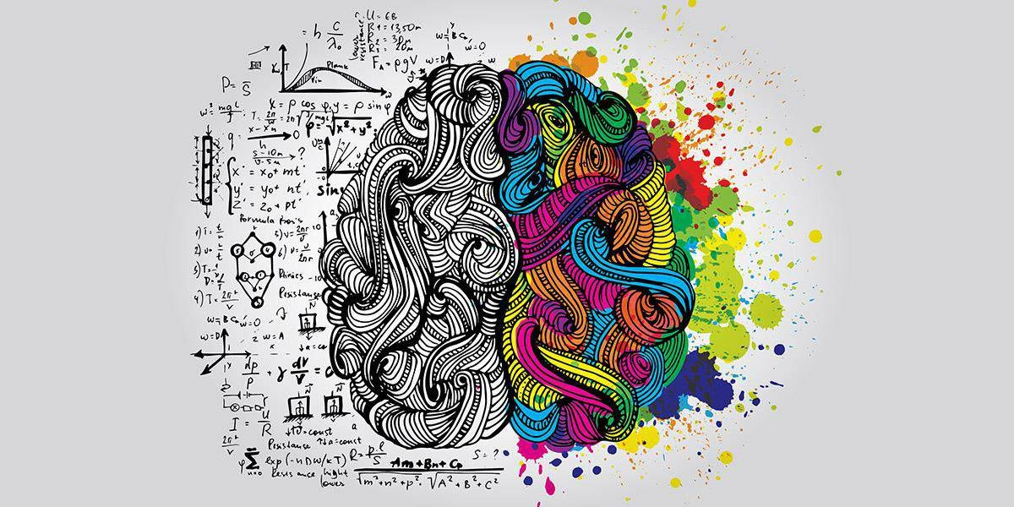
Emotional Impact
Colors can evoke specific feelings and memories.
They influence our mood and Behavior in subtle ways.

Slide 5


Cultural Context
Color interpretations vary across cultures.
What's cheerful in one society might be somber in another.

Slide 6

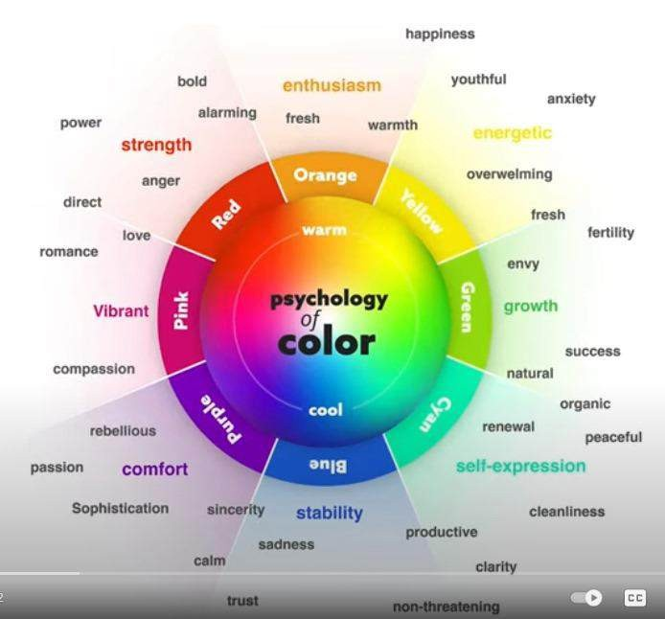

Slide 7

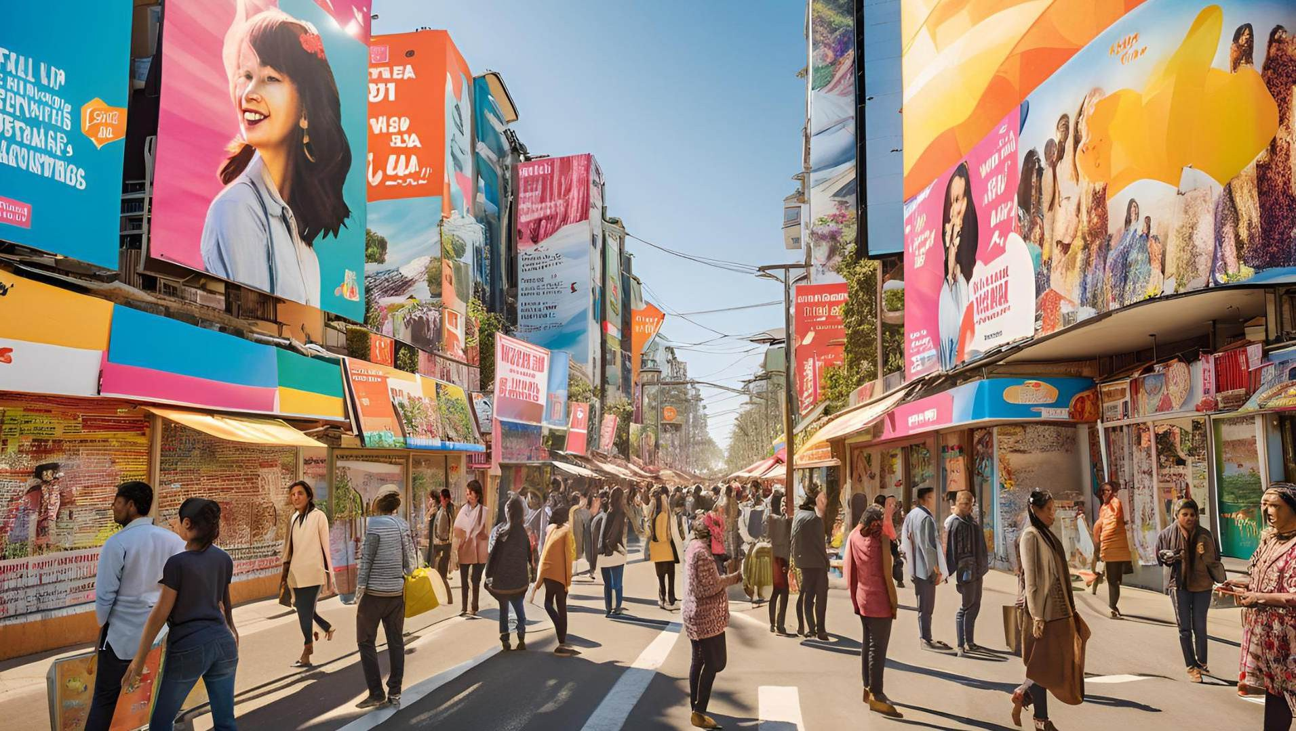













Warm
Colors

Slide 8
RED

Slide 9
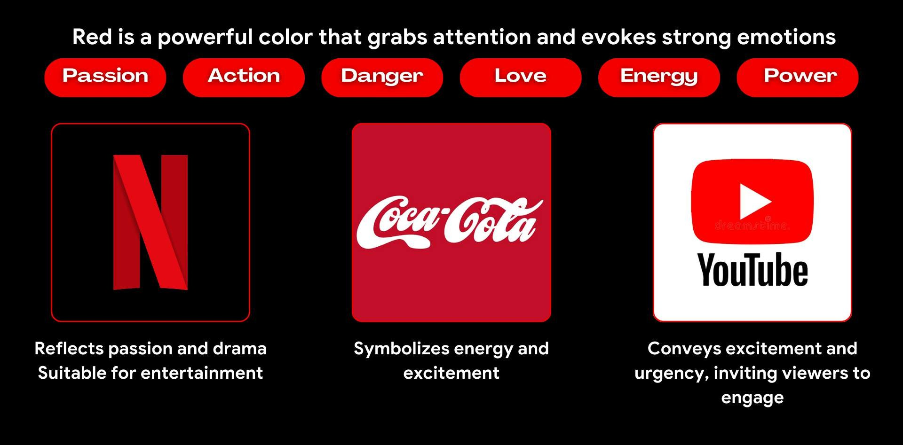
RE D

Slide 10
Yellow

Slide 11
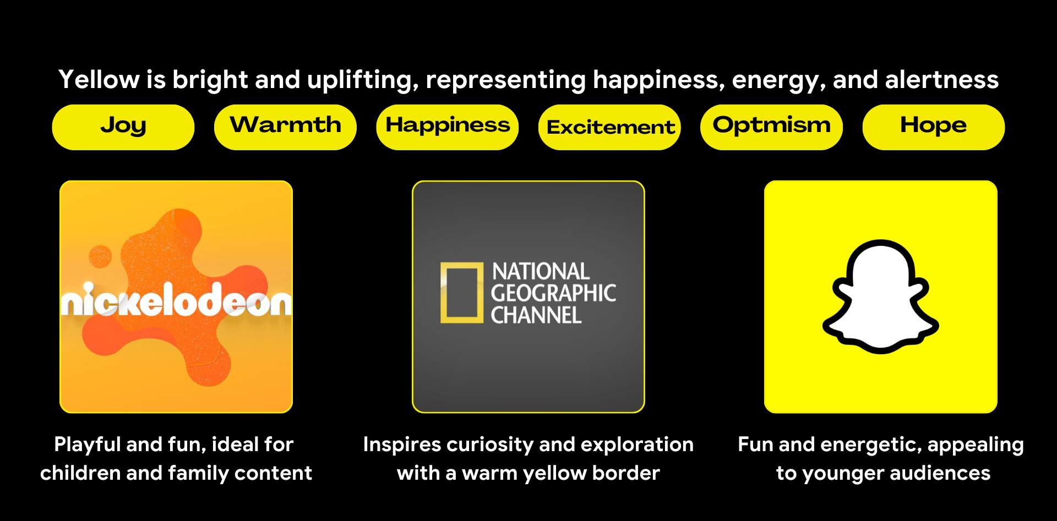
Yellow

Slide 12
Orange

Slide 13
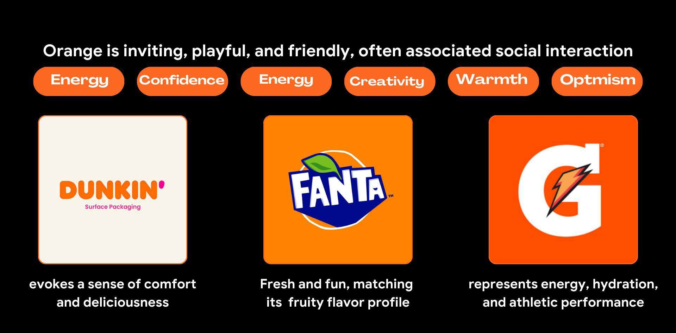
Orange

Slide 14
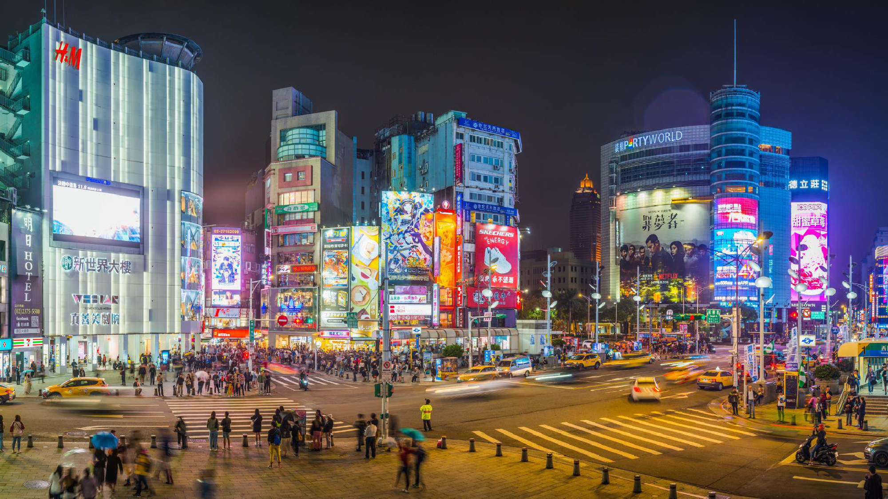










Cool Colors
BLU E
Green
purple

Slide 15




BLU E

Slide 16


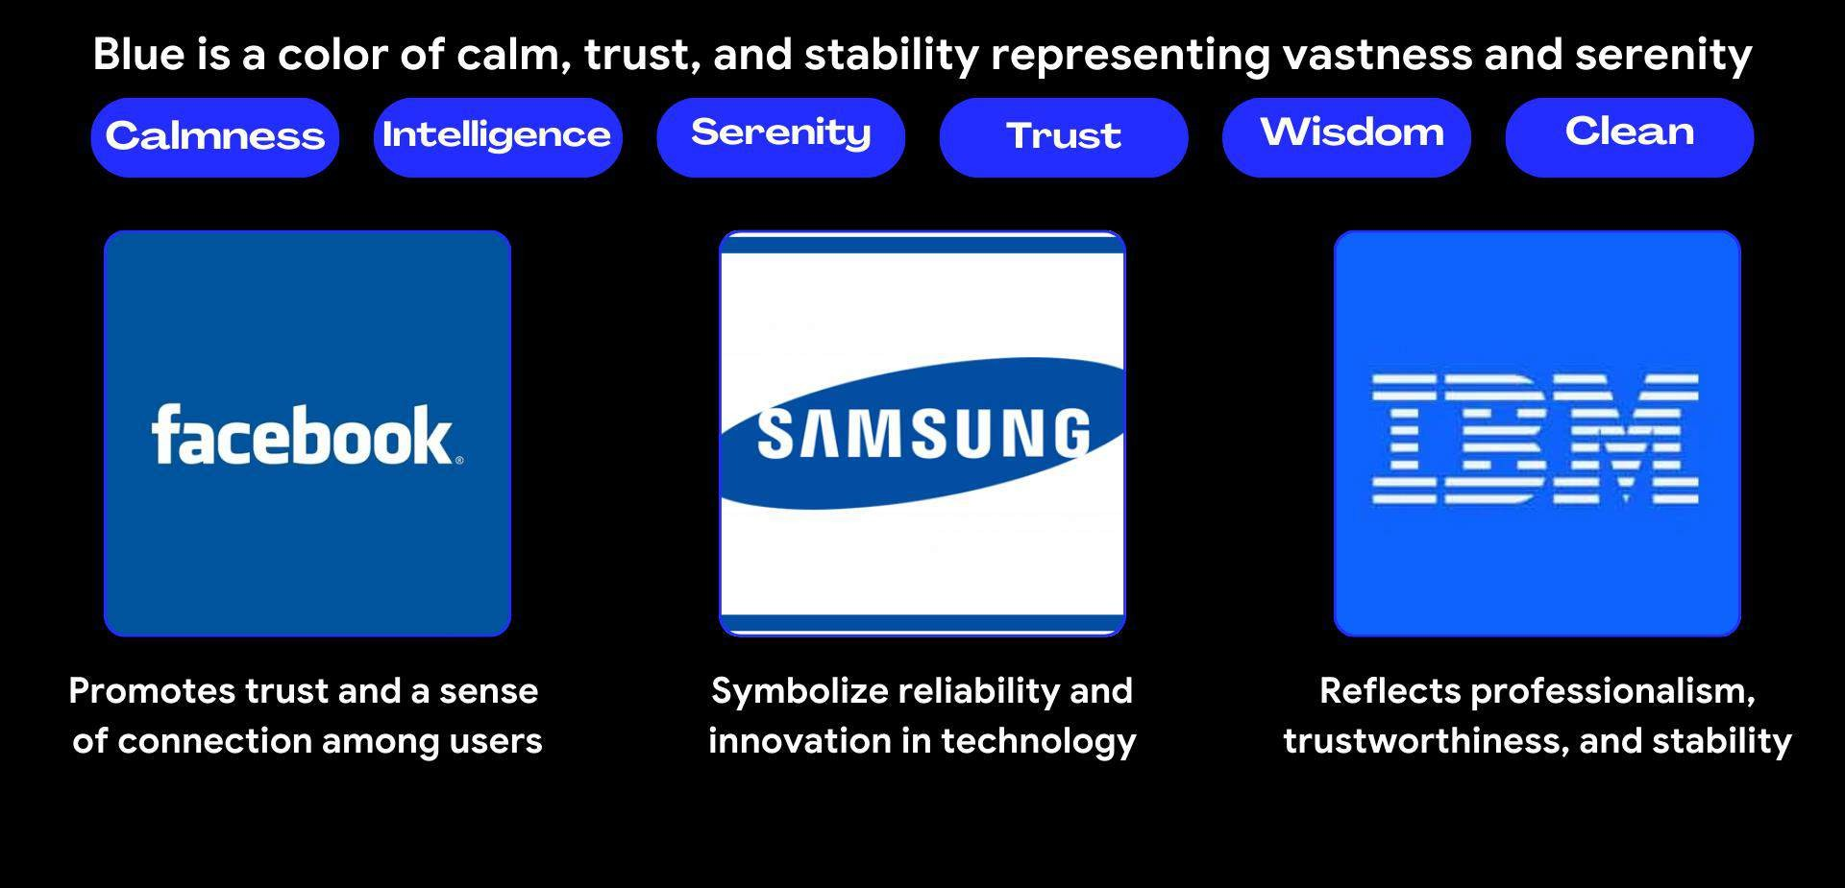
BLUE

Slide 17


Green

Slide 18

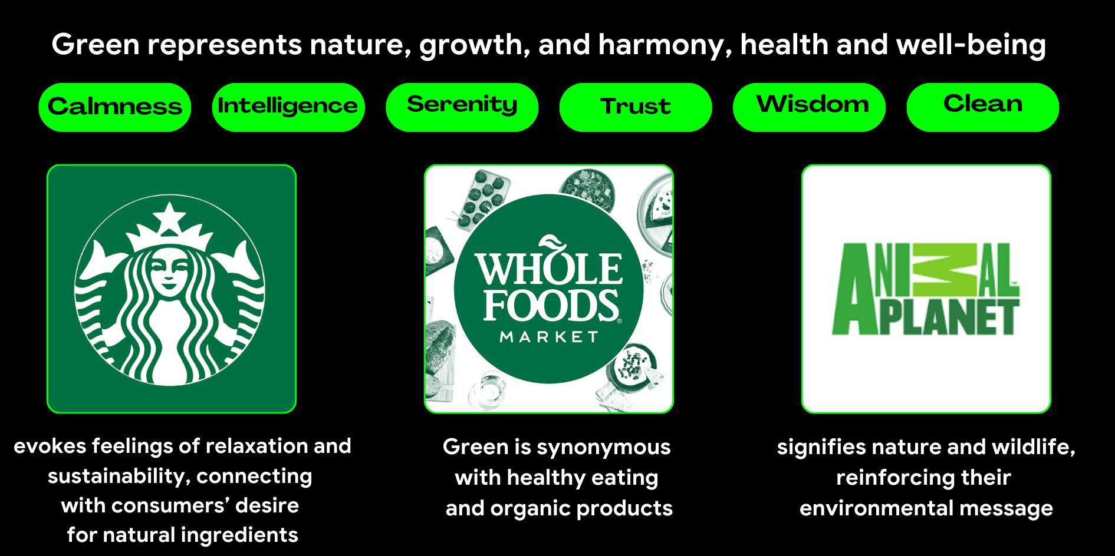
Green

Slide 19


purple

Slide 20

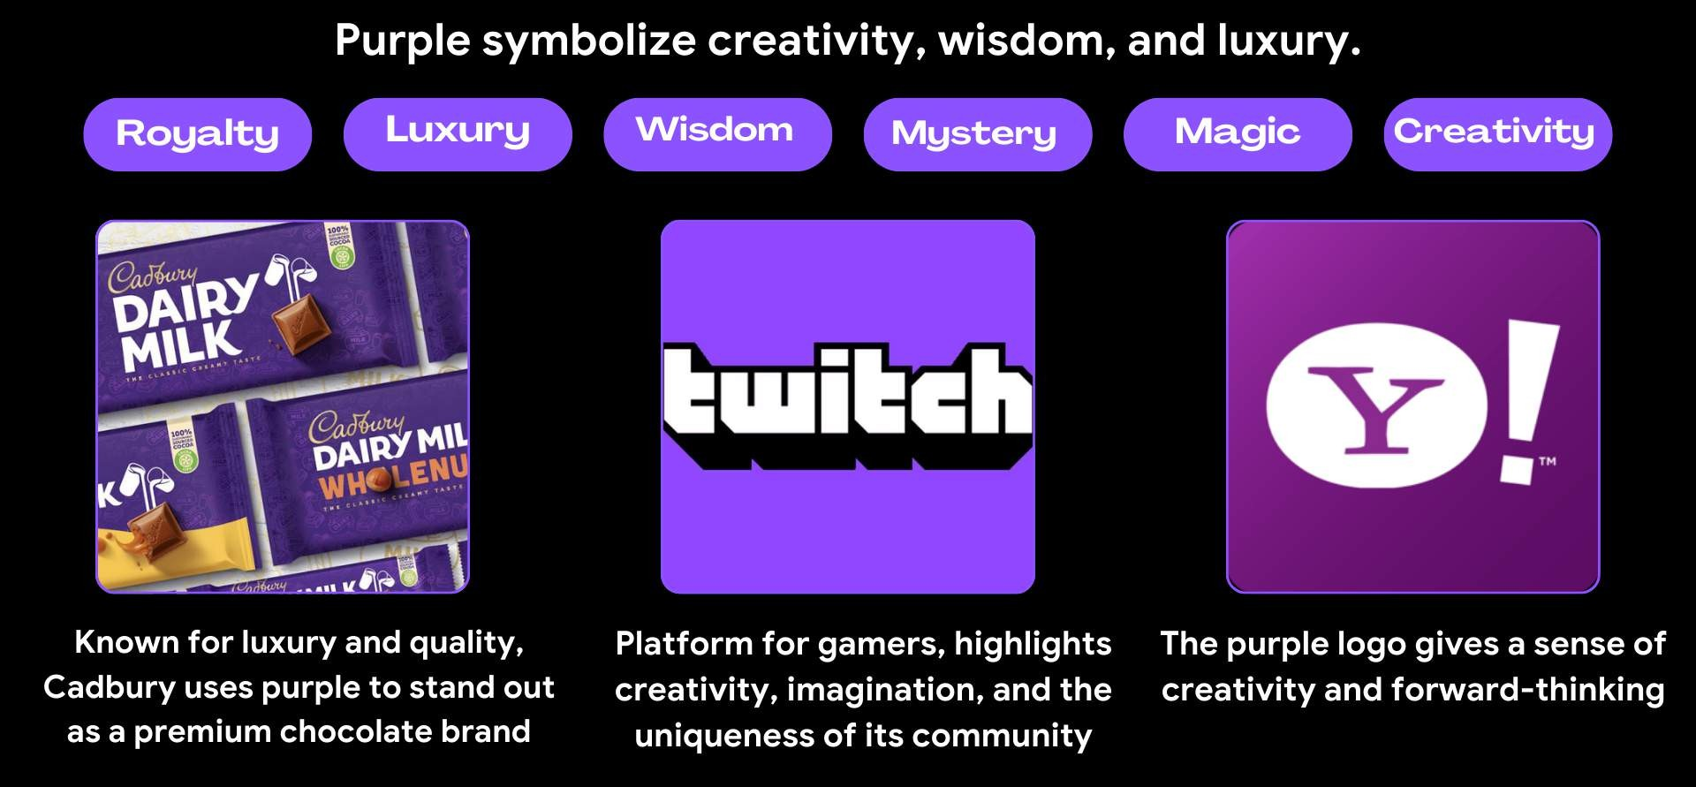
purple

Slide 21






Neutral Colors

Slide 22



Neutral Colors
Neutral colors like black, white, gray, beige, and brown
don’t necessarily evoke specific emotions as warm and cool colors do, but they play a crucial role in design and psychology. These colors can either
support or balance other colors, helping to create a harmonious and focused
environment. They’re often associated with qualities like calmness, professionalism, simplicity, and sophistication.

Slide 23


1.

Slide 24


1.Oh Sorry !

Slide 25
1. Black

Slide 26
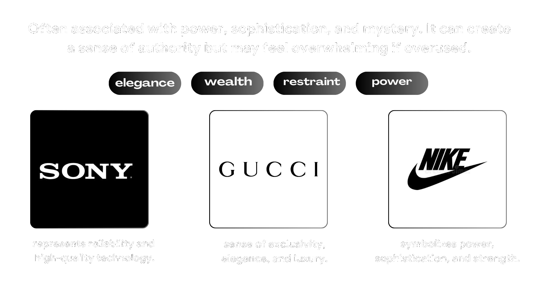
1. Black

Slide 27
2. White

Slide 28

2. White

Slide 29
3. Brown

Slide 30
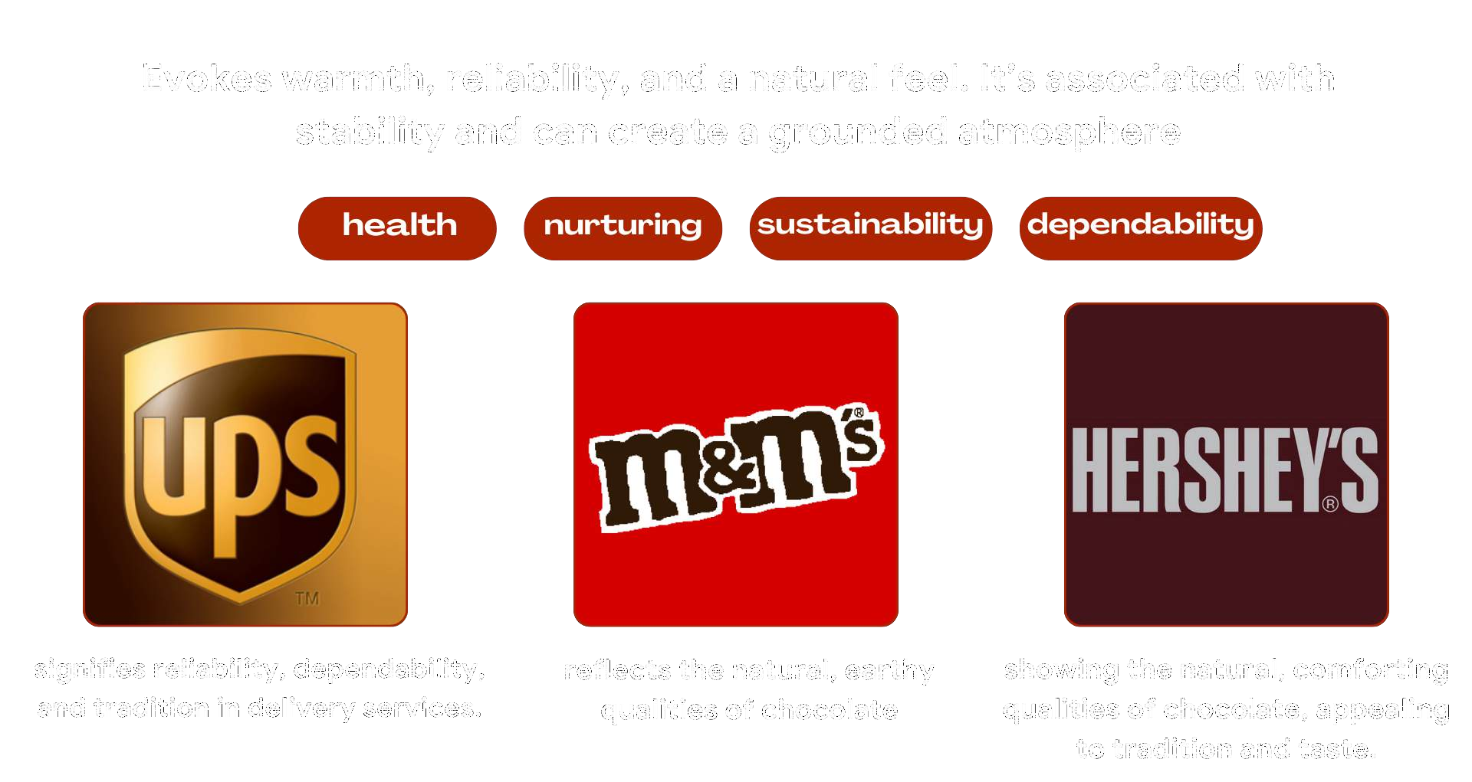
3. Brown

Slide 31
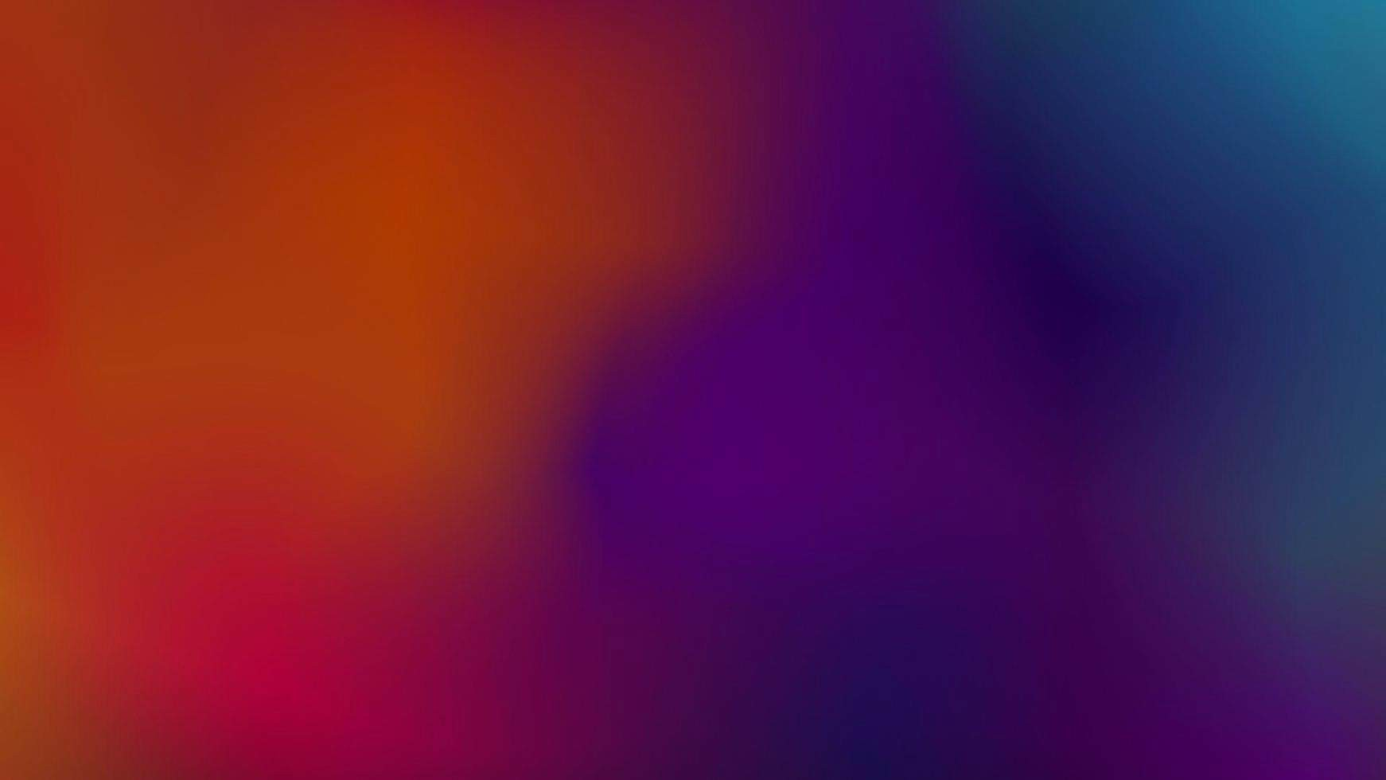
Applications of
Color Psychology

Slide 32
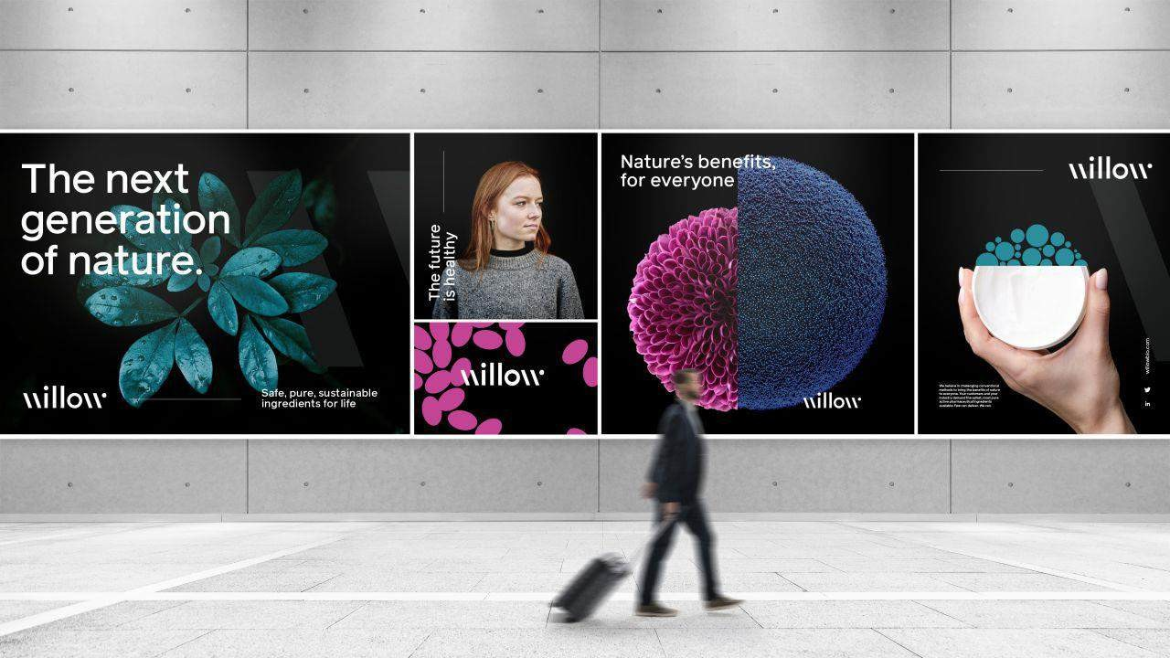

Marketing and Branding
Companies use color psychology to shape brand perception.
For example, fast-food chains use warm colors to increase appetite, while financial institutions use blue for trustworthiness.

Slide 33
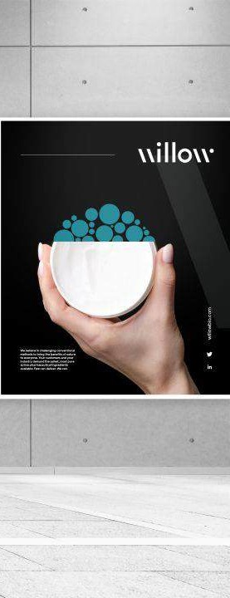
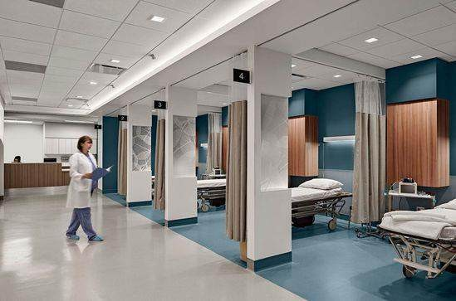

Interior Designs
Colors impact mood in physical spaces, like hospitals using green and blue for a calming effect or offices using white and gray for a clean, professional look

Slide 34


Healthcare
Therapists and wellness spaces often use cool and neutral
colors to create a peaceful environment for clients.

Slide 35
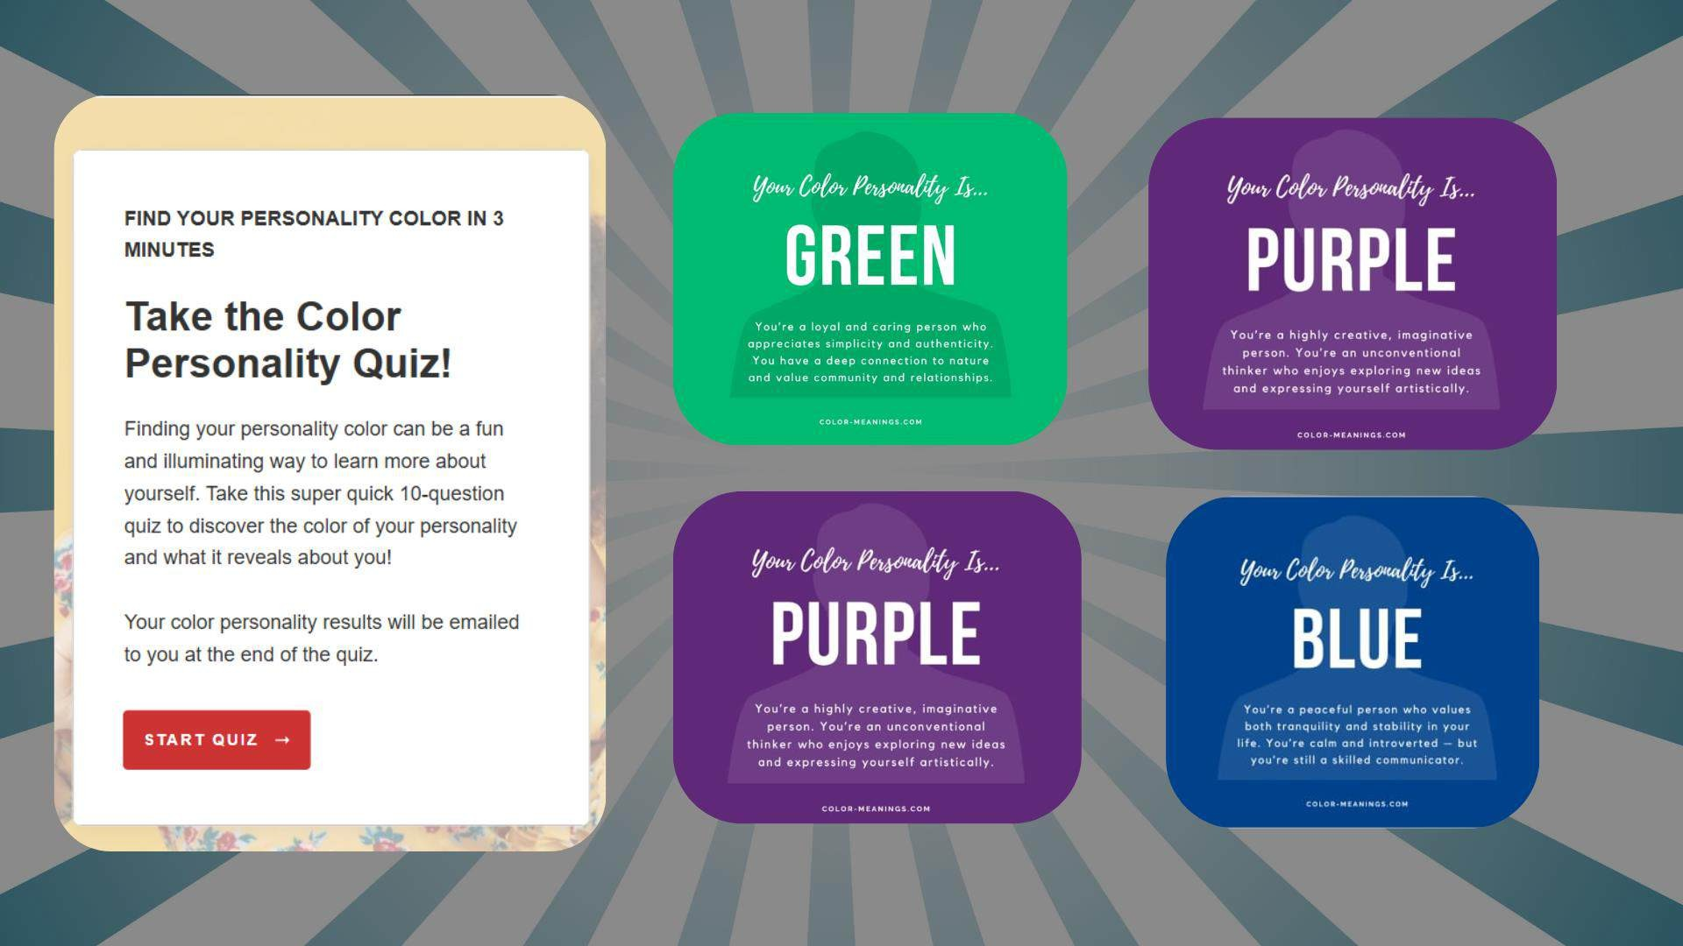

Slide 36



